Slide 1


Session 9
Python Syntax - 1
MODULES

Slide 2
Learning Outcomes
1.Types of modules
Built-in Modules
Installed Modules
user created modules
2.Getting started with the PyAutoGui Module
3.Creating simple Modules

Slide 3
What is MODULE
A module can define functions, classes, and variables. A module can also include runnable code. Grouping related code into a module makes the code easier to understand and use. It also makes the code logically organized.
syntax for module
module_name.function_name.
1. Built-in Modules
Few Modules come in handy in everyday programming. So these modules come preinstalled when you install Python. So you can directly install and start using these modules.
To import a module we can use the following syntax (there are multiple ways to import a module this is just one of them)
import module_name
import time
print("hello")
time.sleep(2)
print("world")
hello
world

Slide 4
2. Installed Modules
All Modules apart from the Built-in ones need to be installed to be able to use them. Almost all the modules created by the users can be found on the PyPi website
Installing modules is pretty straightforward
For Windows
open the command prompt and type
pip install module_name
For Mac
open Terminal and type
pip3 install module_name
NOTE: The instructions to install a module can be found on the PyPi project page itself. See the next page image.
We can open a command prompt or terminal on Windows to use the command shown to install the module
To verify if the module is installed properly we can try importing the module
import pyautogui

Slide 5
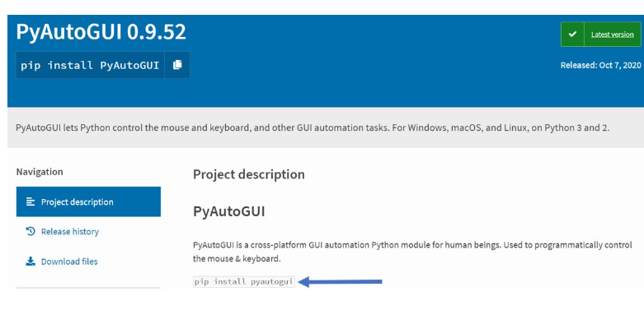
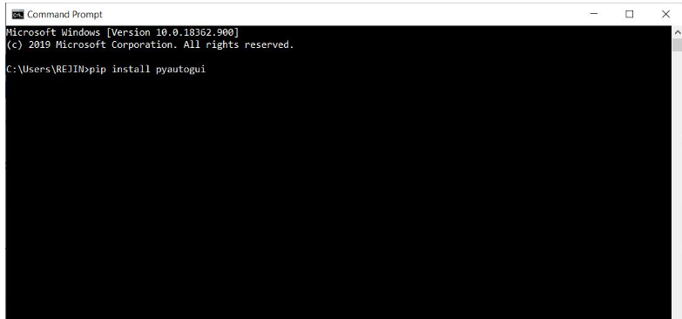

Slide 6
3. Creating a Banking App using Functions user-defined module
The App should have the following features
Simple Tasks
1.Create an account (During account creation username, password, and the initial deposit amount should be specified.)
2. The account holders should be able to log in and log out from the account using a password.
3. Account holders should be allowed to credit and debit Money.
Difficult Tasks
1.Remove Account Holder
2. The app should have checks which limit the withdrawal of amounts bigger than the current balance in the account.
3. Should have a way to check the current balance

Slide 7
1. Make use of the function for each task
def function_name():
2. Use a dictionary of dictionaries to store the account holder details
acc_hold = {"user1":{"pass":1234, "bal":50000}, "user2":{"pass":5678, "bal":20000}}
Global variables used for program state
login = False
running = True
hon to take in input from users While taking inputs we have an option to prompt the user.
NOTE: Functions will always have open and close brackets
input("enter a number : ")
enter a number: 1000
'1000'
The above line of code does not make sense as we are taking input from the user and not storing it anywh

Slide 8
HOMEWORK
1. Write a Python program to generate a random alphabetical character, alphabetical string, and alphabetical string of a fixed length.
2. Write a Python program to construct a seeded random number generator, also generate a float between 0 and 1, excluding 1.
3. Write a Python program to select a random element from a list, set, dictionary (value), and a file from a directory.
4. Write a Python program to generate a float between 0 and 1, inclusive, and generate a random float within a specific range.
5. Write a Python program to create a list of random integers and randomly select multiple items from the said list.
6.Write a Python program to configure the rounding to round up and round down a given decimal value. Use decimal. Decimal

Slide 9
HOMEWORK SOLUTION
#TASK 1 import random
import string
print("Generate a random alphabetical character:")
print(random.choice(string.ascii_letters))
print("\n Generate a random alphabetical string:")
max_length = 255
str1 = ""
for i in range(random.randint(1, max_length)):
str1 += random.choice(string.ascii_letters)
print(str1)
print("\n Generate a random alphabetical string of a fixed length:")
str1 = ""
for i in range(10):
str1 += random.choice(string.ascii_letters)
print(str1)

Slide 10
HOMEWORK SOLUTION
#TASK 2 import random
print("Construct a seeded random number generator:")
print(random.Random().random())
print(random.Random(0).random())
print("\n Generate a float between 0 and 1, excluding 1:")
print(random.random())

Slide 11
THANK - YOU

